Slide 1

Movie Censorship Assistance Using ML/DL Techniques
Project Category : Research
TO YOU BY:
MOHAMMED NOWFAL[RA2111047010032]
BALA.S[RA2111047010021]
Guide Name: Dr.Gopinath
Department :CINTEL

Slide 2
CONTENT
Abstract
Introduction
Literature Survey
Limitations from Literature Survey
Research Objectives
System Architecture
Model Inference
References

Slide 3
Abstract
As the amount of movie content continues to grow, there is a pressing need for automated solutions to help moderate and rate this content, especially when it comes to spotting foul language and scenes of violence or blood. This project aims to create a powerful machine learning model that can detect and timestamp these sensitive instances in movies.
Our approach will combine several advanced techniques: Convolutional Neural Networks (CNNs) will analyze the video frames, recurrent neural networks (RNNs) will handle the audio features, and cutting-edge Natural Language Processing (NLP) methods will scrutinize the subtitles. By merging these different types of data, our system aims to accurately identify and log when and where inappropriate content appears.
We plan to train our model using publicly available datasets that come with annotations, and we will measure its performance with precision, recall, and F1-score metrics. This innovative solution is designed to make content moderation more scalable and efficient, helping ensure that movies meet appropriate viewing standards while significantly reducing the need for manual reviews.

Slide 4
Introduction
Importance in Film Industry
Movie censorship plays a significant role in safeguarding cultural sensitivities, protecting viewers, and maintaining ethical boundaries in film content creation. It shapes the narrative and ensures films align with acceptable norms.
Significance
Exploring movie censorship is essential as it influences viewers' experiences, shapes industry practices, and reflects the evolving landscape of societal values and beliefs in the cinematic realm
Contextualize Movie Censorship
Movie censorship is the process of restricting or limiting certain content in films to comply with societal standards or legal requirements. Understanding movie censorship is crucial to grasp its impact on storytelling and audience perception.

Slide 5
Literature Survey

Slide 6
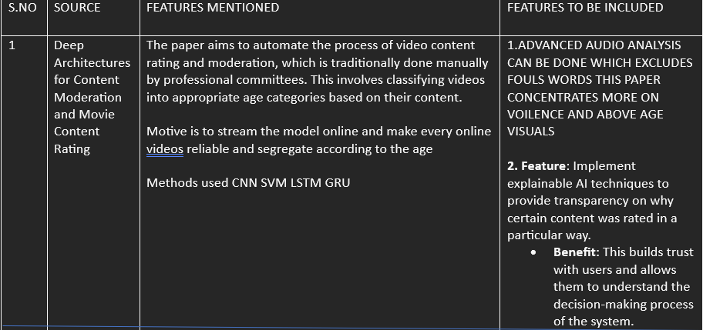
Published On & %3D&el=1_x_2&_esc=publicationCoverPdf
By: Feb 22 https://www.researchgate.net/publication/360812725_Machine_Learning_Models_for_Content_Classification_in_Film_Censorship_and_Rating?enrichId=rgreq-f97443c3dad2124fb6a183844ba779fe-XXX&enrichSource=Y292ZXJQYWdlOzM2MDgxMjcyNTtBUzoxMTYwNjkyMTc4NjU3MjgxQDE2NTM3NDE5ODgzNTI

Slide 7
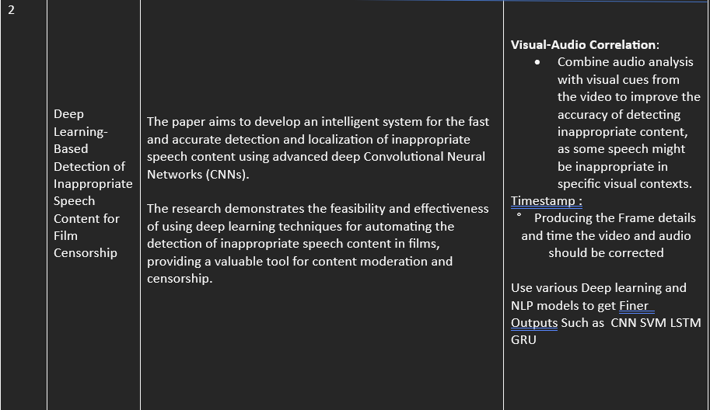
ABDULAZIZ SALEH BA WAZIR , HEZERUL ABDUL KARIM , (Senior Member, IEEE), HOR SUI LYN, (Student Member, IEEE), MOHAMMAD FAIZAL AHMAD FAUZI , (Senior Member, IEEE), SARINA MANSOR , AND MOHD HARIS LYE , (Member, IEEE)
https://drive.google.com/drive/folders/1XPMPcfw45dbEOOezU3t7eLGtaKEFAfSQ?usp=sharing

Slide 8
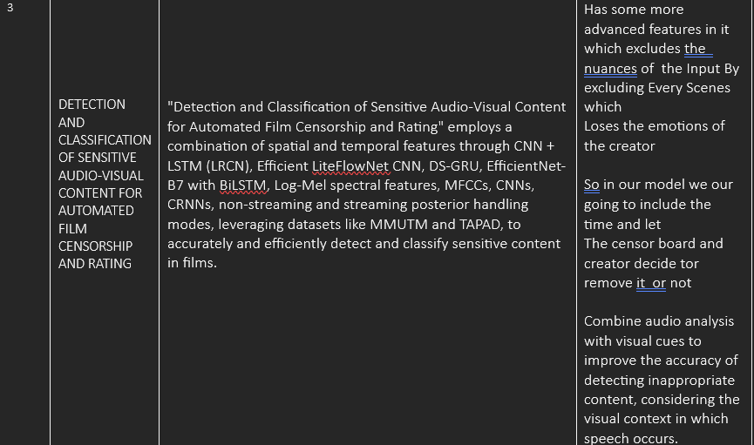
Published on 2023
https://drive.google.com/drive/folders/1XPMPcfw45dbEOOezU3t7eLGtaKEFAfSQ?usp=sharing

Slide 9
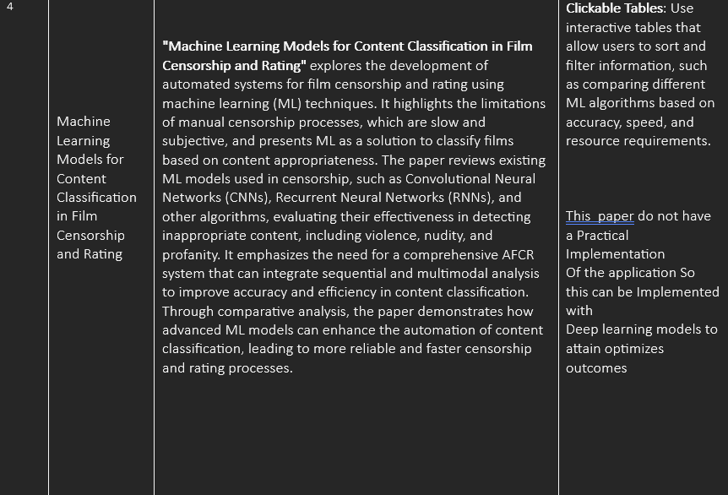
Published On & By: Feb 22 https://www.researchgate.net/publication/360812725_Machine_Learning_Models_for_Content_Classification_in_Film_Censorship_and_Rating?enrichId=rgreq-f97443c3dad2124fb6a183844ba779fe-XXX&enrichSource=Y292ZXJQYWdlOzM2MDgxMjcyNTtBUzoxMTYwNjkyMTc4NjU3MjgxQDE2NTM3NDE5ODgzNTI%3D&el=1_x_2&_esc=publicationCoverPdf

Slide 10
Limitations from Literature Survey
Contextual Sensitivity: Struggles with detecting nuanced content, potentially leading to over-censorship or missed sensitive material.
Creative Impact: May diminish the emotional and narrative value by rigidly excluding scenes, affecting the creator's intent.
Synchronization Issues: Combining audio and visual analysis requires precise synchronization, and any misalignment could result in inaccurate censorship.
Human Dependency: Final content decisions still rely on human judgment, leading to potential inconsistency in censorship practices

Slide 11
Research Objectives
Module 1: Introduction and Background
This model introduces the need for automated film censorship and rating, moving beyond traditional manual methods. It reviews current content moderation techniques, identifying their limitations, and sets the objective to create an AI-driven solution.
Module 2: Methodology
This model outlines the system architecture, focusing on using deep learning models like CNN LSTM OR GRU for analyzing visual and audio content. It details how features like violence, blood, and profanity are detected through feature extraction.
Module 3: Implementation and Results
This model summarizes the tools and processes used to build the AFC system, addressing any implementation challenges. It presents the setup for testing and evaluates the system's performance, highlighting its accuracy and effectiveness compared to existing methods.

Slide 12
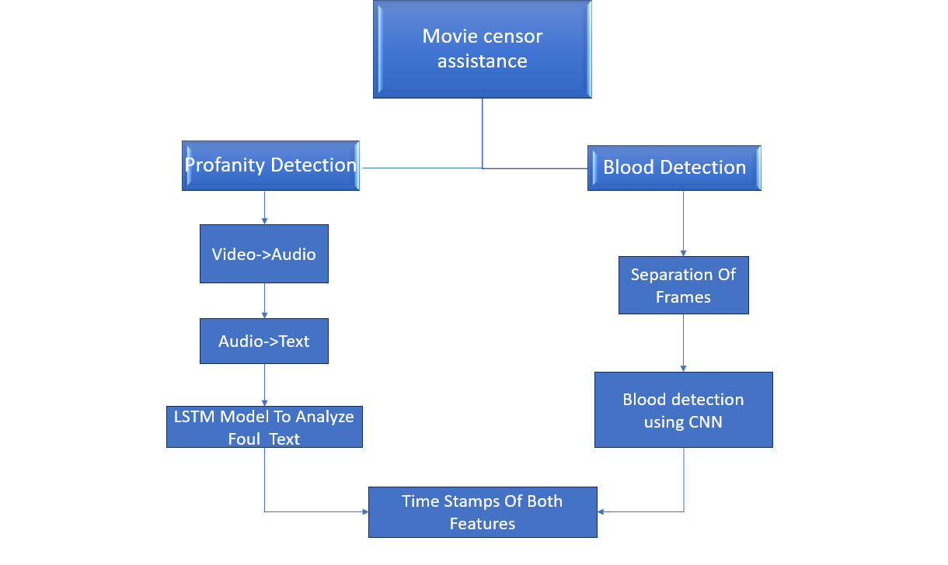
Architecture Diagram

Slide 13
Architecture Diagram Representing the whole idea of Censorship Assistance
Output Timestamps
Censorship
Assistance
video
Data Preprocessing
Timestamp
mapping
Preprocessing
Model Inference
1.Violence
2.Blood
3.profanity
Map To Film Duration
Feature Extraction
Frame Extraction
Audio Transcription
Visual Features
Text Analysis
Extract frames from Video
Convert Audio To Text
Result Storage
Violence Detection
Blood Detection

Slide 14
MODEL FOR VISUAL FEATURE: VIOLENCE DETECTION(CNN) BLOOD DETECTION(CNN)
Detecting Violence
Feature Extraction:
CNNs analyze frames to identify violent actions by detecting specific visual patterns such as aggressive movements, weapons, and physical confrontations. Early layers capture basic features, while deeper layers recognize complex patterns associated with violence.
Model Training and Inference:
CNNs are trained on labeled data with violent and non-violent scenes, learning to differentiate between them. During inference, the model processes new video frames and outputs probabilities or labels indicating the presence of violence.
Detecting Blood
Color and Texture Analysis:
CNNs detect blood by analyzing color patterns (e.g., red hues) and textures associated with blood in video frames. The network’s early layers focus on identifying these basic features, while later layers recognize specific patterns and contexts related to blood.
Training and Classification:
Training involves using annotated frames with visible blood to teach the CNN to recognize blood patterns. The model classifies frames during inference to identify and output timestamps where blood is detected.

Slide 15
MODEL FOR AUDIO FEATURE: PROFANITY CHECK(LSTM)
1. Contextual Understanding
LSTM networks excel at capturing contextual information by processing sequences of words and maintaining long-term dependencies, which helps in detecting subtle or context-dependent profanity.
2. Sequential Data Processing
LSTM processes text data sequentially, learning patterns from the entire context of a sentence or paragraph, making it effective for identifying profanity based on its usage in different contexts.
3. Training and Inference
Train LSTM models on labeled text data with examples of profanity and non-profane content. The trained model can then classify new text sequences, identifying and flagging instances of profanity accurately.

Slide 16
Challenges Encountered During The Build
Dataset Availability
Difficulty in finding publicly available, high-quality datasets specifically for blood detection.
Need for manual dataset preparation and organization from multiple sources.
System Compatibility
Limited computational resources affected model training efficiency.
Inability to work with resource-intensive architectures like InceptionV3 due to hardware constraints.
Model Limitations
Challenges in optimizing simpler models to achieve comparable performance for image classification.
Trade-off between accuracy and model complexity for real-time applications.
Fine-Tuning and Preprocessing
Extensive preprocessing required for consistent image quality.
Struggles with overfitting due to limited data size in certain categories.

Slide 17
Solutions to Challenges
Custom Dataset Creation
Extracted and labeled relevant data from movie scenes to build our own dataset tailored for blood detection.
Ensured diverse representation to improve model learning.
Cloud-Based Solutions
Utilized cloud platforms like Google Colab to overcome system limitations.
Benefited from free GPU/TPU access and optimized RAM usage for model training.
System Compatibility Checks
Conducted rigorous compatibility tests to identify suitable configurations.
Iteratively refined our process to work within hardware and software constraints.
Simpler Models for Feasibility
Leveraged compact models like CNN and LSTM to balance performance with resource requirements.
Achieved lower accuracy but established a foundation for future improvements.
Learning and Iterative Improvement
Adopted a trial-and-error approach, learning from failures and refining our techniques.
Set the groundwork for scaling the project into a robust, high-accuracy system in the future.

